Slide 1
Transaction Processing

Slide 2
Transaction Concept
Collections of operations that form a single logical unit of work are called transactions.
A transaction is a unit of program execution that accesses and possibly updated various data items.
Normally, a transaction is initiated by a user program written in a programming language.
The transaction consists of all operations executed between the begin transaction and end transaction.

Slide 3
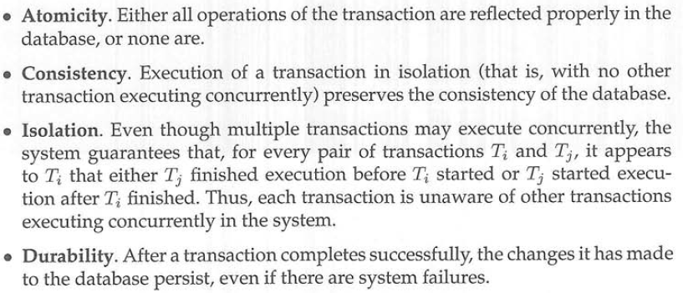
To ensure integrity of the data, we require that the database system maintain the following properties of the transaction:
These properties are often called the ACID properties.

Slide 4
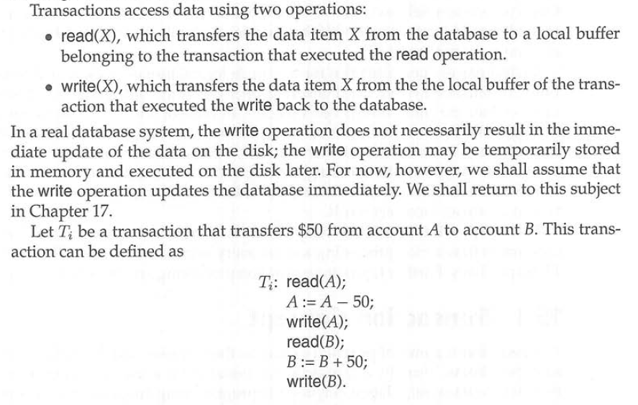

Slide 5
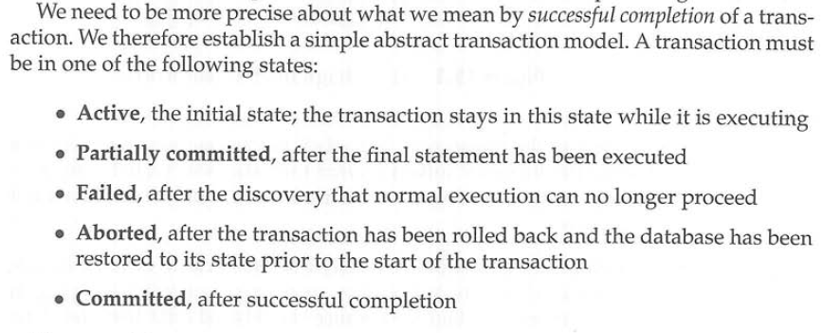
Transaction State

Slide 6
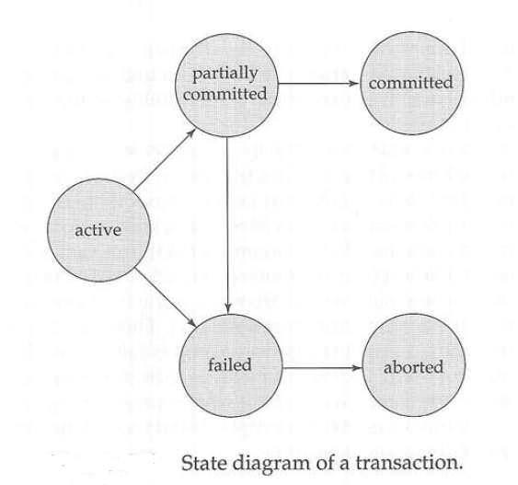

Slide 7
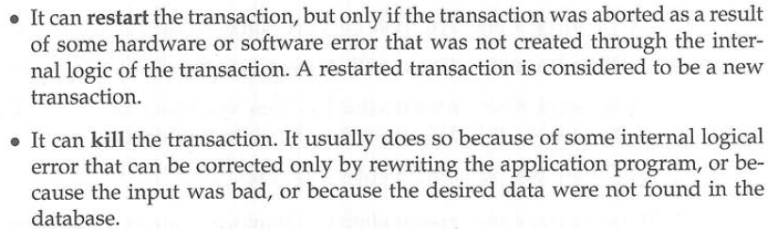

Slide 8
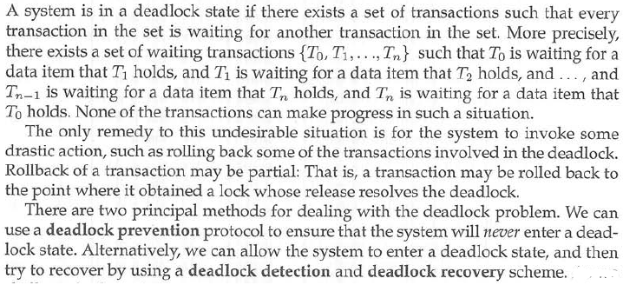
Deadlock Handling
1. Deadlock Prevention
. Wait-Die Scheme.
. Wound-Wait Scheme.
. Timeout-Based Schemes.
2. Deadlock Detection
3. Deadlock Recovery

Slide 9
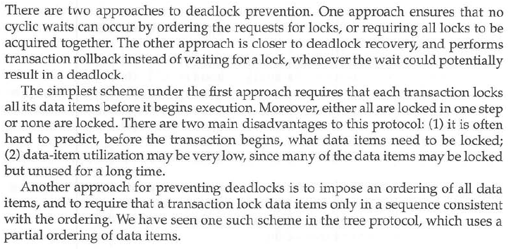
Deadlock Prevention

Slide 10
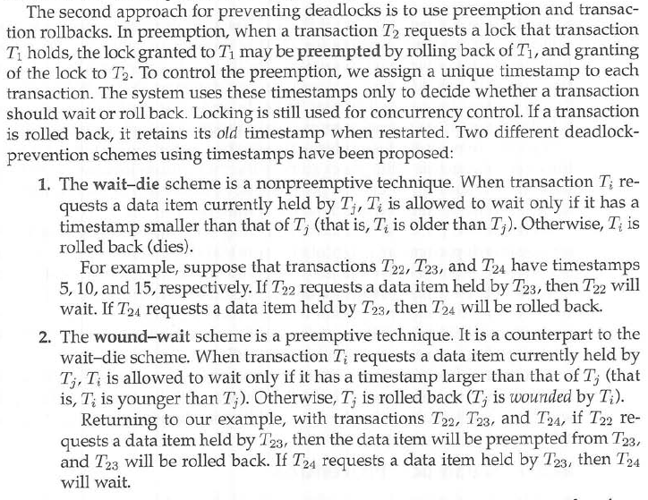

Slide 11
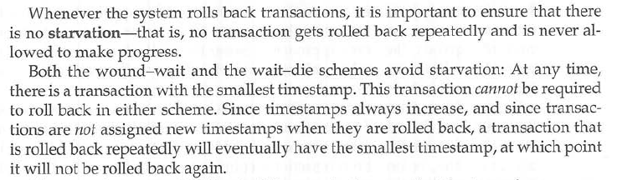

Slide 12
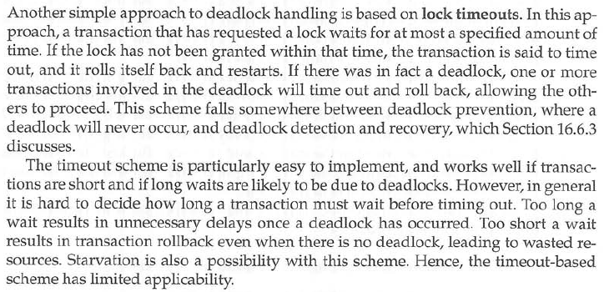
Timeout-Based Schemes

Slide 13
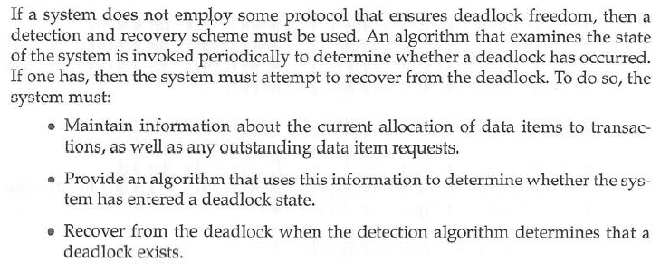
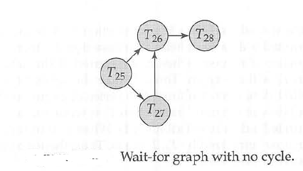
Deadlock Detection And Recovery

Slide 14
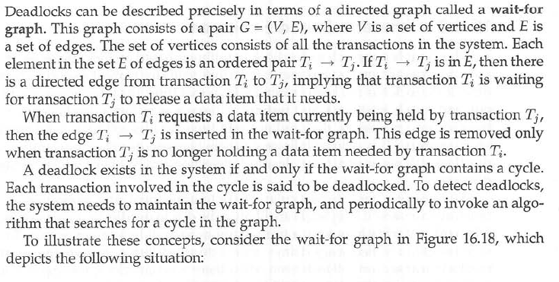
Deadlock Detection

Slide 15
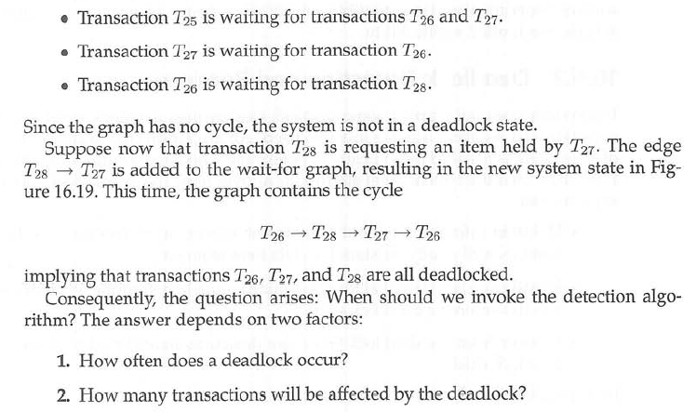

Slide 16
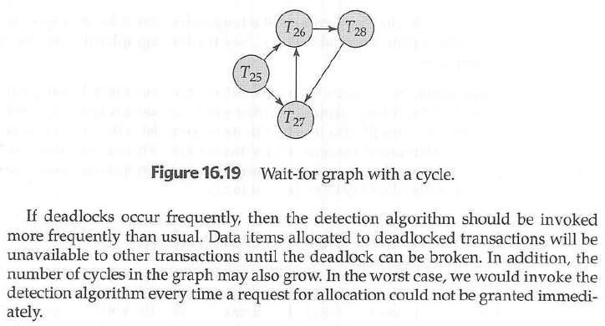

Slide 17
Recovery From Deadlock
Selection of a Victim.
Rollback.
Starvation.

Slide 18
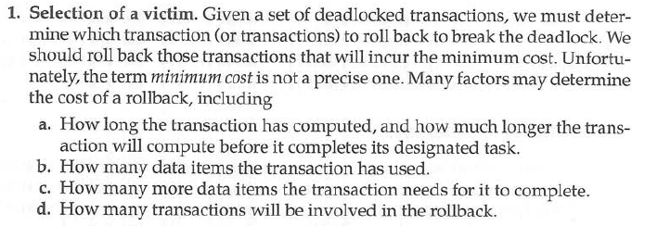
Selection of a Victim

Slide 19
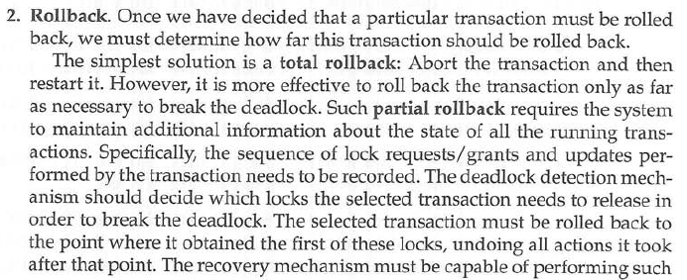

Rollback

Slide 20
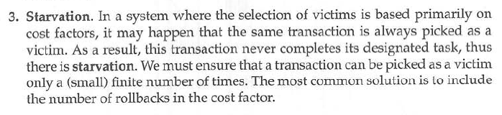
Starvation

Slide 21
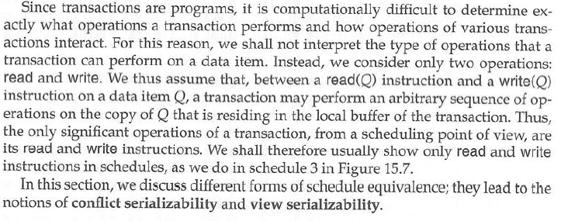
Serializability
Conflict Serializabilty (Conflict Equivalence S S’(after Swapping))
View Serializability ( 3 Conditions R,(R/W (Same output) (W (Final Value)))

Slide 22
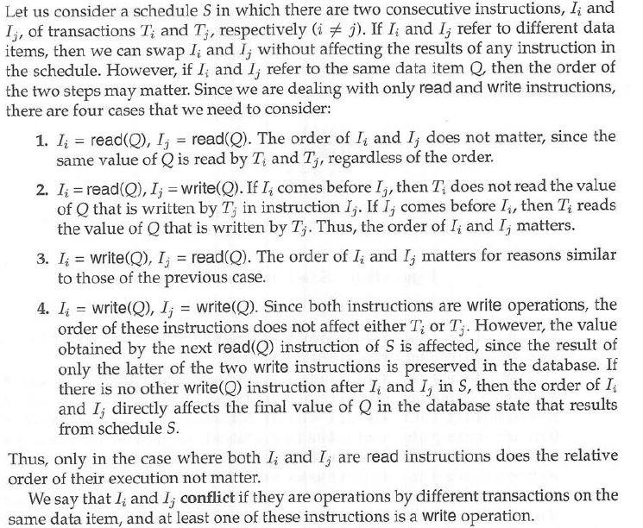
Conflict Serializabilty

Slide 23
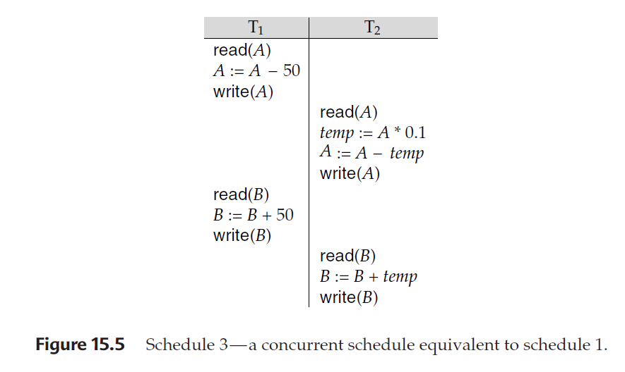

Slide 24
Schedule – 3 (A Concurrent schedule equivalent to schedule 1 )
T₁ T₂
Read(A)
A:=A-50
Write(A)
Read(A)
Temp:=A*0.1;
A:=A-temp
Write(A)
Read(B)
B:=B+50
Write(B)
Read(B)
B:=B+temp
Write(B)

Slide 25
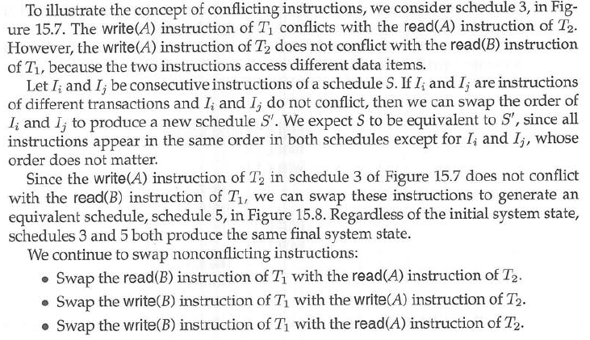

Slide 26
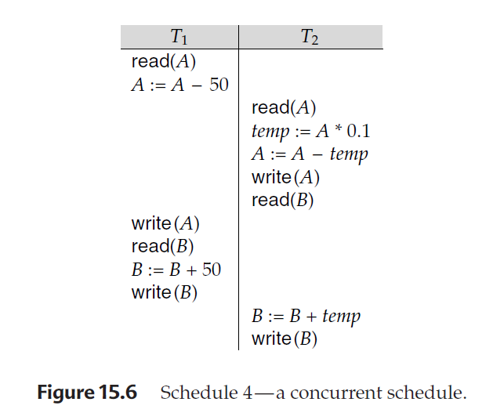

Slide 27
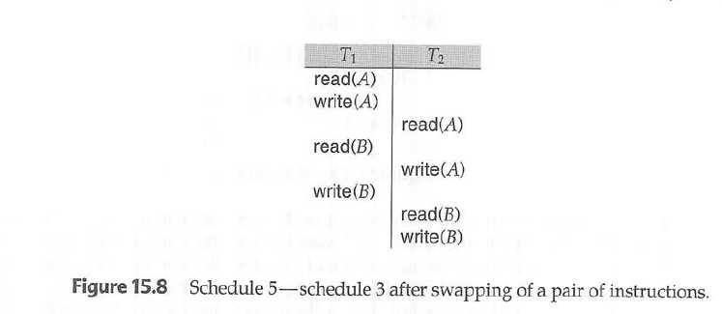

Slide 28
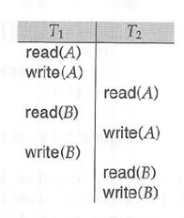
T₁ T₂
Read(A)
A:=A-50
Write(A)
Read(A)
Temp:=A*0.1;
A:=A-temp
Write(A)
Read(B)
B:=B+50
Write(B)
Read(B)
B:=B+temp
Write(B)
Schedule 5 – Schedule 3 after swapping of a pair of instructions

Slide 29
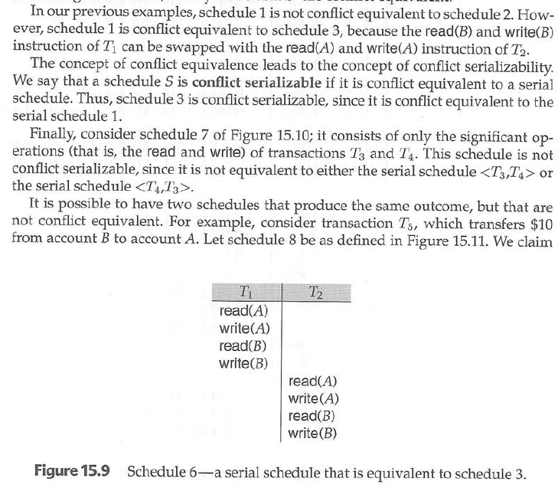

Slide 30
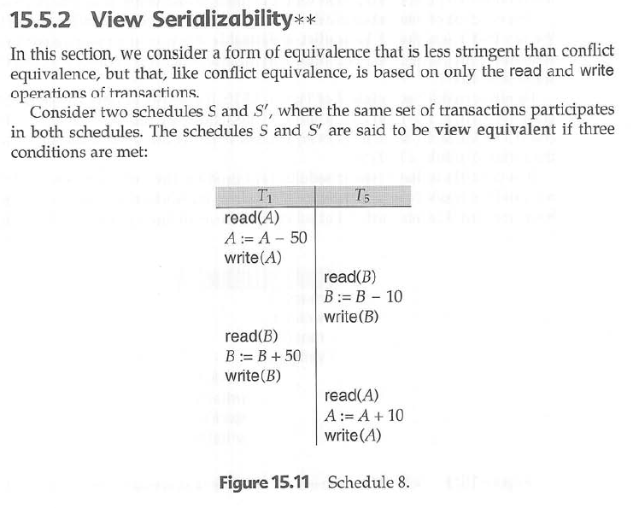

Slide 31
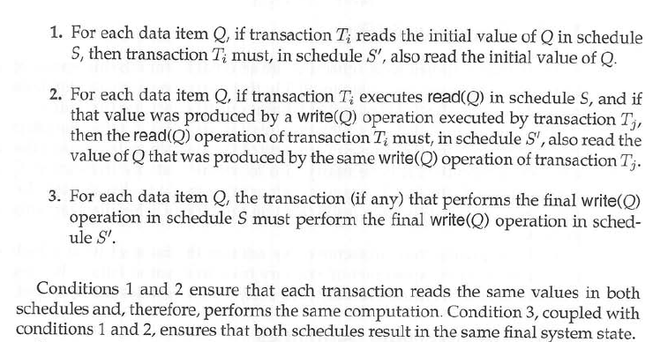

Slide 32
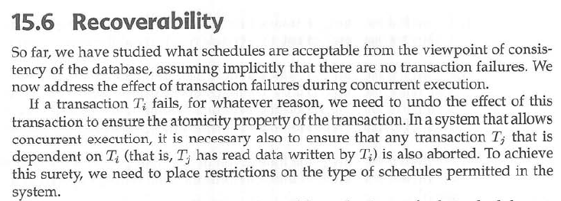

Slide 33
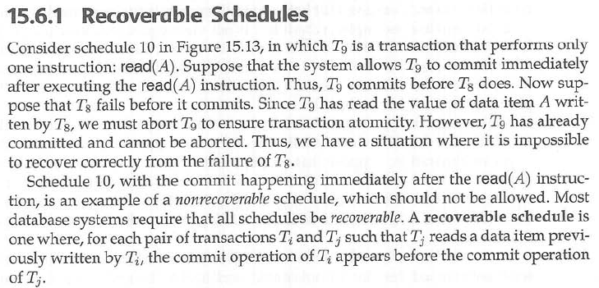
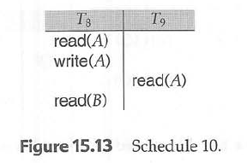

Slide 34
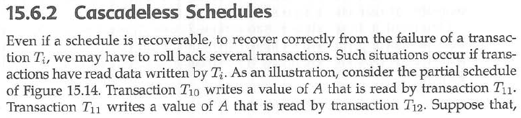
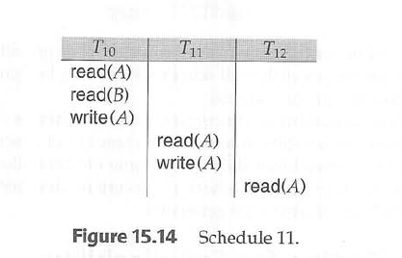

Slide 35
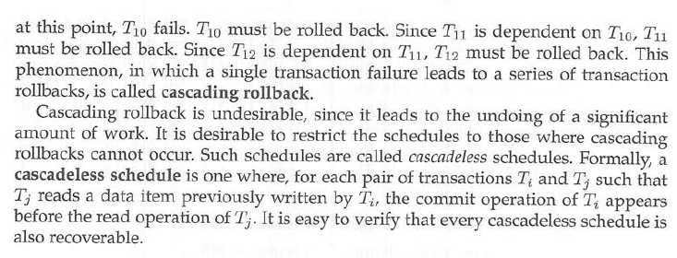

Slide 36
VIEW IN SQL
SQL CREATE VIEW Statement
In SQL, a view is a virtual table based on the result-set of an SQL statement.
A view contains rows and columns, just like a real table. The fields in a view are fields from one or more real tables in the database
SQL CREATE VIEW Syntax
CREATE VIEW view_name AS SELECT column_name(s) FROM table_name WHERE condition

Slide 37
SQL CREATE VIEW Examples
The view "Current Product List" lists all active products (products that are not discontinued) from the "Products" table. The view is created with the following SQL:
CREATE VIEW [Current Product List] AS SELECT ProductID, ProductName FROM Products WHERE Discontinued=No
We can query the view above as follows:
SELECT * FROM [Current Product List]

Slide 38
SQL Updating a View
You can update a view by using the following syntax:
SQL CREATE OR REPLACE VIEW Syntax
CREATE OR REPLACE VIEW view_name AS SELECT column_name(s) FROM table_name WHERE condition
Now we want to add the "Category" column to the "Current Product List" view. We will update the view with the following SQL:
CREATE OR REPLACE VIEW [Current Product List] AS SELECT ProductID,ProductName,Category FROM Products WHERE Discontinued=No

Slide 39
SQL Dropping a View
You can delete a view with the DROP VIEW command.
SQL DROP VIEW Syntax
DROP VIEW view_name

